Slide 1
Step by Step
How to Create a Video From Images Saved on Your Computer

Slide 2
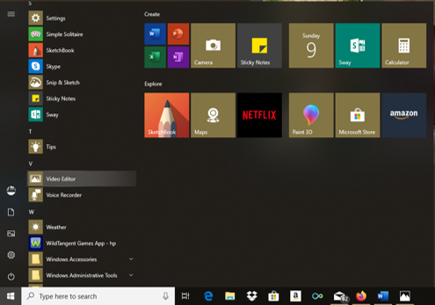
Scroll down your list of installed programs and click on Video Editor

Slide 3
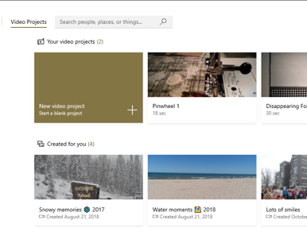
When this window pops up click on the “New Video Project” box

Slide 4
The (2) projects shown below are the first two trial videos I made with this program
This bottom row shows 3 of 4 videos my HP Video Editor created and saved, and I never knew they existed until I opened this program 2 days ago!

Slide 5
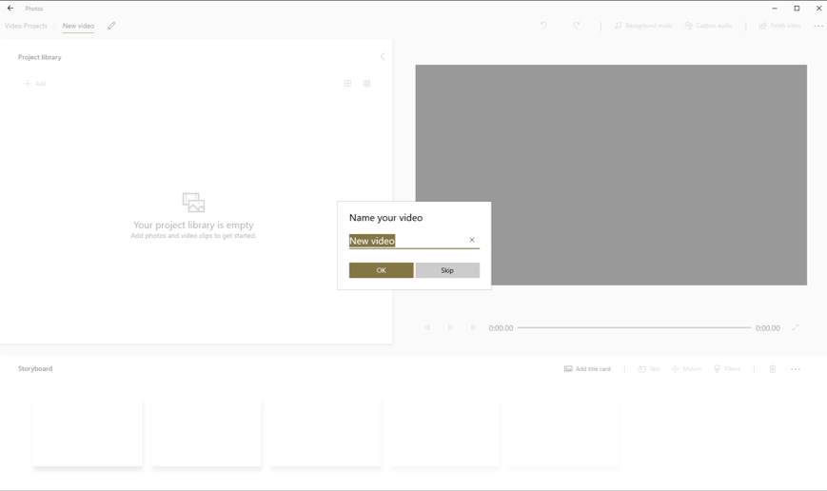
Before you go any further it will ask you to give a name to your video

Slide 6
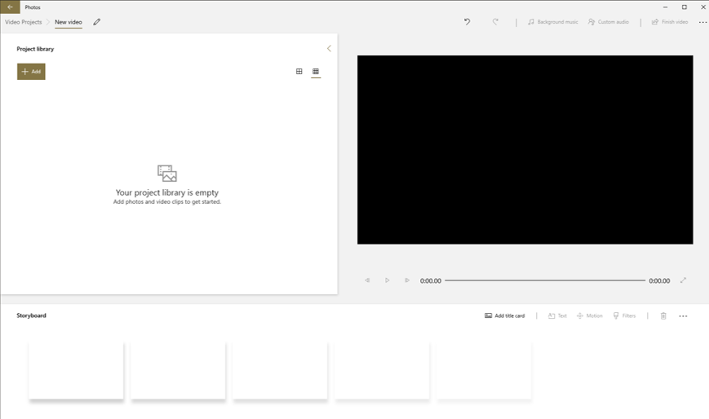
Next, click the “Add” button

Slide 7
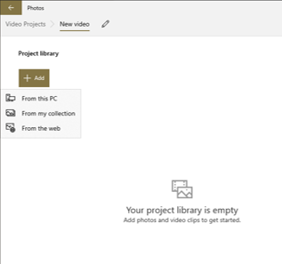
This drop-down menu appears giving you the option to choose from where you want to upload the files
that will appear in your video.

Slide 8
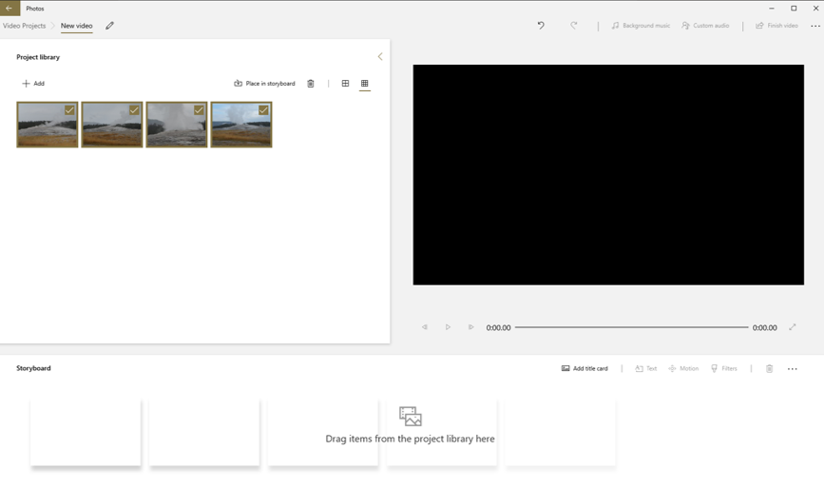
For this example I chose these four images from a folder saved on my computer.
I wanted to show the sequence of activity of Old Faithful so I choose pictures that were taken fairly close together.

Slide 9
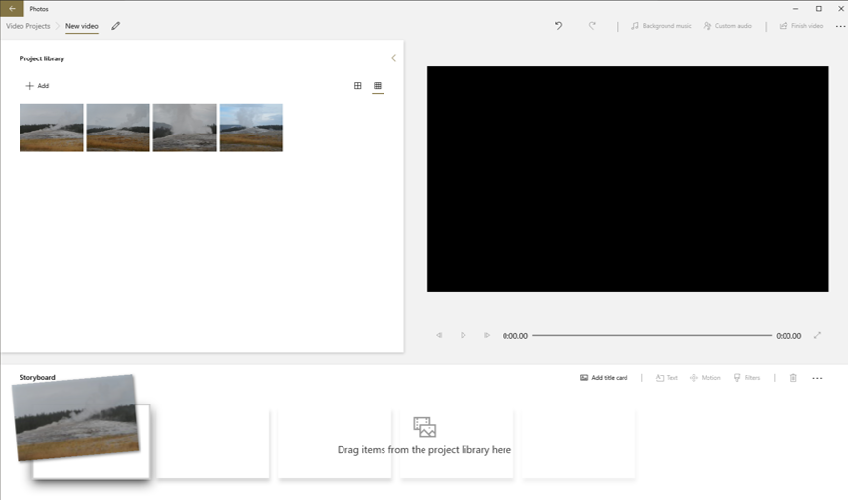
Next, I simply dragged and dropped each image down into the storyboard below in the order I want them to appear in the video.
If, after placing each image onto the storyboard and you see you need to rearrange the order, no problem. Just grab an image, drag and drop it anywhere along the storyboard where you want it.

Slide 10
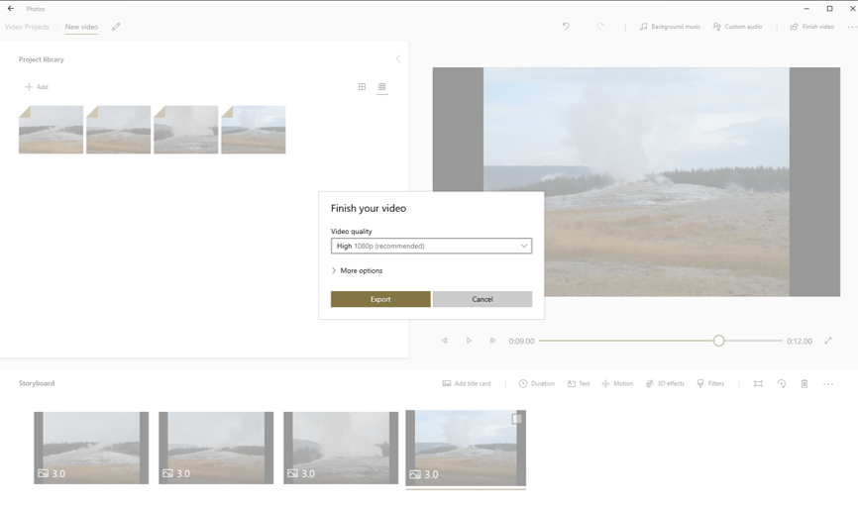
Almost there!
1. Click “Finish Video”
2. This menu pops up giving you 3 choices - It is suggested to choose the High-quality output setting.
3. Click “Export” and the image you see is your completed video.

Slide 11
Before finishing the video there are a couple of things to do first:
If you want background music click on that icon and you are given a choice to use a pre-installed music clip (only one tune available)!
You have the choice to use your own audio clip
Or, you can choose no music at all.
4. The option to create a Title Card is also available.
5. As you can see, several other options are available to customize your video – I’ll be giving those a try in my next video

Slide 12
A Title Card was created for this example. If you place it in front of all other images before finishing, this is how the beginning of your video will appear.

